Slide 1
SEMANTIC MULTIMEDIA FOG COMPUTING AND IOT ENVIROMENT:SUSTAINABILITY PERSPECTIVE
SIJO SAJI
CLASS NO: 58 S7 BTECH CSE
Dept of CSE,MACE Kothamangalam
<number> /
Notes:
hi
dept of se

Slide 2
CONTENTS
SEMANTIC MULTIMEDIA FOG COMPUTING AND IOT ENVIROMENT
  INTRODUCTION
  PROBLEM STATEMENT
  FRAMEWORK DESIGN
  ADDING SEMANTICS TO THE SYSTEM
  RESULTS
  CONCLUSION
Dept of CSE,MACE Kothamangalam
<number> /
Notes:
hi
dept of se

Slide 3
INTRODUCTION
SEMANTIC MULTIMEDIA FOG COMPUTING AND IOT ENVIROMENT
Uses edge devices to carry out substantial amount of:
    Computation
    Storage
    Communication
Dept of CSE,MACE Kothamangalam
<number> /
Notes:
hi
dept of se

Slide 4
INTRODUCTION(CONT.)
SEMANTIC MULTIMEDIA FOG COMPUTING AND IOT ENVIROMENT
Consists of edge nodes
Performs physical input and output
Achieve sensor input and display output
Dept of CSE,MACE Kothamangalam
<number> /
Notes:
hi
dept of se

Slide 5
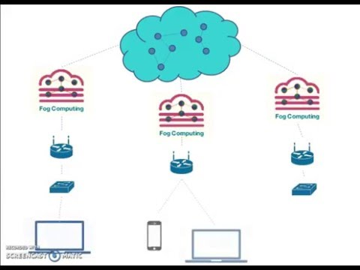
INTRODUCTION(CONT.)
Courtesy:https://images.google.com/
Dept of CSE,MACE Kothamangalam
<number> /
Notes:
hi
dept of se

Slide 6
INTRODUCTION(CONT.)
SEMANTIC MULTIMEDIA FOG COMPUTING AND IOT ENVIROMENT
Data from pcs,smartphones are routed to fog centres
Possess less computational power compared to cloud
Raw sensory data are collected by fog nodes
Processed by the fog centres
Sent back to client
Dept of CSE,MACE Kothamangalam
<number> /
Notes:
hi
dept of se

Slide 7
INTRODUCTION(CONT.)
SEMANTIC MULTIMEDIA FOG COMPUTING AND IOT ENVIROMENT
Complex multimedia like geotagged multimedia
First sent to fog nodes
They process according to their computational ability
The complex part is forwarded to cloud
Dept of CSE,MACE Kothamangalam
<number> /
Notes:
hi
dept of se

Slide 8
APPLICATION: EXAMPLE
SEMANTIC MULTIMEDIA FOG COMPUTING AND IOT ENVIROMENT
An example on application of fog computing:
Driverless car using current network not advisable
Distance from obstacle is sent to cloud
Decisions are made at cloud end
Dept of CSE,MACE Kothamangalam
<number> /
Notes:
hi
dept of se

Slide 9
APPLICATION: EXAMPLE
SEMANTIC MULTIMEDIA FOG COMPUTING AND IOT ENVIROMENT
The cloud infrastructure would be miles away
Latency would be high
May lead to accidents
Dept of CSE,MACE Kothamangalam
<number> /
Notes:
hi
dept of se

Slide 10
APPLICATION: EXAMPLE(CONT.)
SEMANTIC MULTIMEDIA FOG COMPUTING AND IOT ENVIROMENT
Fog node will be a computer would be fitted inside the car
The raw sensory data from the sensors are analysed
The node makes decision
Reduces latency and workload on cloud
Dept of CSE,MACE Kothamangalam
<number> /
Notes:
hi
dept of se

Slide 11
PROBLEM STATEMENT
SEMANTIC MULTIMEDIA FOG COMPUTING AND IOT ENVIROMENT
A pilgrimage poses challenges to smart city services
A large no.of contexts of people are generated
Smartphone a context manager
A smartphone is equipped with capabilities of a PC
Dept of CSE,MACE Kothamangalam
<number> /
Notes:
hi
dept of se

Slide 12
Dept of CSE,MACE Kothamangalam
<number> /

Slide 13
Dept of CSE,MACE Kothamangalam
<number> /

Slide 14
Dept of CSE,MACE Kothamangalam
<number> /

Slide 15
Dept of CSE,MACE Kothamangalam
<number> /

Slide 16
PROBLEM STATEMENT(CONT.)
SEMANTIC MULTIMEDIA FOG COMPUTING AND IOT ENVIROMENT
The required data for processing can be derived using
Crowdsourcing
Crowd sensing activities
Data is sent back to client as a needed service
Dept of CSE,MACE Kothamangalam
<number> /
Notes:
hi
dept of se

Slide 17
PROBLEM STATEMENT(CONT.)
SEMANTIC MULTIMEDIA FOG COMPUTING AND IOT ENVIROMENT
Smartphone cannot be considered a full time online node due to:
Security
Battery Drainage issue
Dept of CSE,MACE Kothamangalam
<number> /
Notes:
hi
dept of se

Slide 18
PROBLEM STATEMENT(CONT.)
SEMANTIC MULTIMEDIA FOG COMPUTING AND IOT ENVIROMENT
Large amount of raw sensory data every second
Leads to bottlenecks at cloud end
Leads to high power consumption
Dept of CSE,MACE Kothamangalam
<number> /
Notes:
hi
dept of se

Slide 19
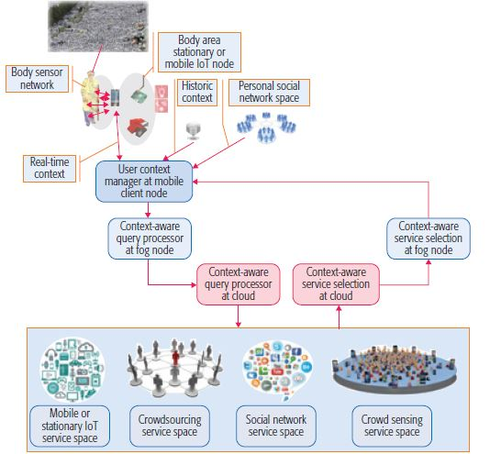
FRAMEWORK DESIGN
SEMANTIC MULTIMEDIA FOG COMPUTING AND IOT ENVIROMENT
Courtesy:https://ieeexplore.ieee.org/document/8360855/
Dept of CSE,MACE Kothamangalam
<number> /
Notes:
hi
dept of se

Slide 20
FRAMEWORK DESIGN(CONT.)
SEMANTIC MULTIMEDIA FOG COMPUTING AND IOT ENVIROMENT
The BSN of a person collects health data of a person
This data is converted to form a context
This data is first sent to the fog node for service
Then the information is sent to the cloud
Dept of CSE,MACE Kothamangalam
<number> /
Notes:
hi
dept of se

Slide 21
FRAMEWORK DESIGN(CONT.)
SEMANTIC MULTIMEDIA FOG COMPUTING AND IOT ENVIROMENT
The cloud provide context aware service using data from:
Iot nodes
crowd-sourcing
social network space
This data is sent to fog nodes
Data is shown in an interface provided by smartphone
Dept of CSE,MACE Kothamangalam
<number> /
Notes:
hi
dept of se

Slide 22
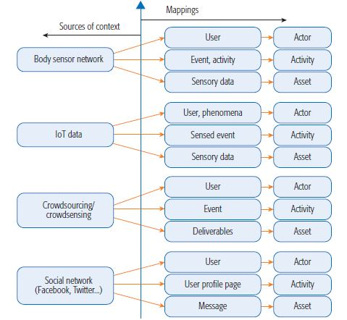
FRAMEWORK DESIGN(CONT.)
SEMANTIC MULTIMEDIA FOG COMPUTING AND IOT ENVIROMENT
Courtesy:https://ieeexplore.ieee.org/document/8360855/
Dept of CSE,MACE Kothamangalam
<number> /
Notes:
hi
dept of se

Slide 23
ADDING SEMANTICS TO THE SYSTEM
SEMANTIC MULTIMEDIA FOG COMPUTING AND IOT ENVIROMENT
Assimilate different units of contextual data
Combine them and use semantic rules
Define higher level contexts
Semantic is generated
Dept of CSE,MACE Kothamangalam
<number> /
Notes:
hi
dept of se

Slide 24
ADDING SEMANTICS TO THE SYSTEM(CONT.)
SEMANTIC MULTIMEDIA FOG COMPUTING AND IOT ENVIROMENT
Example: The iot nodes housed at various locations
They collect raw data
Like air quality and types of gases
Data is collected at regular intervals
Semantic such as green zone of the area is deduced
Dept of CSE,MACE Kothamangalam
<number> /
Notes:
hi
dept of se

Slide 25
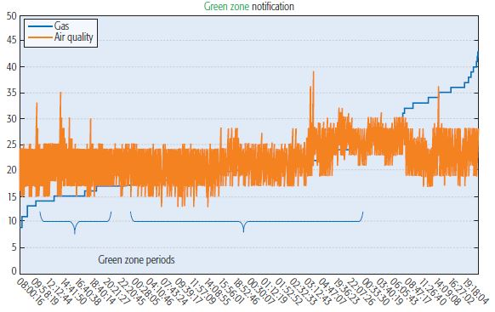
ADDING SEMANTICS TO THE SYSTEM(CONT.)
SEMANTIC MULTIMEDIA FOG COMPUTING AND IOT ENVIROMENT
Courtesy:https://ieeexplore.ieee.org/document/8360855/
Dept of CSE,MACE Kothamangalam
<number> /
Notes:
hi
dept of se

Slide 26
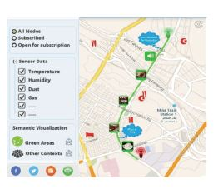
ADDING SEMANTICS TO THE SYSTEM(CONT.)
SEMANTIC MULTIMEDIA FOG COMPUTING AND IOT ENVIROMENT
Courtesy:https://ieeexplore.ieee.org/document/8360855/
Dept of CSE,MACE Kothamangalam
22 /
Notes:
hi
dept of se

Slide 27
ADDING SEMANTICS TO THE SYSTEM(CONT.)
SEMANTIC MULTIMEDIA FOG COMPUTING AND IOT ENVIROMENT
User can subscribe to raw data or just the semantics like
green zone
water-clogged area
Semantics are shown in form of multimedia
Dept of CSE,MACE Kothamangalam
<number> /
Notes:
hi
dept of se

Slide 28
RESULTS
SEMANTIC MULTIMEDIA FOG COMPUTING AND IOT ENVIROMENT
Proposed framework was found to be energy efficient
Two experiments were conducted
Energy consumption per hour of a random day
Energy consumption per day over two weeks
Dept of CSE,MACE Kothamangalam
<number> /
Notes:
hi
dept of se

Slide 29
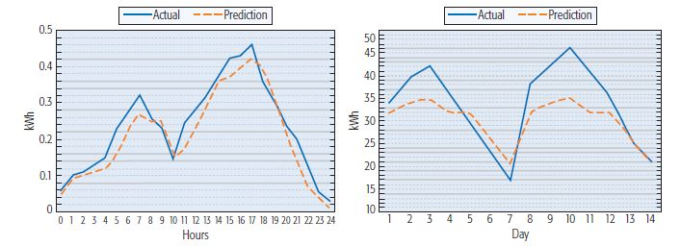
RESULTS(CONT.)
SEMANTIC MULTIMEDIA FOG COMPUTING AND IOT ENVIROMENT
Courtesy:https://ieeexplore.ieee.org/document/8360855/
Dept of CSE,MACE Kothamangalam
<number> /
Notes:
hi
dept of se

Slide 30
CONCLUSION
SEMANTIC MULTIMEDIA FOG COMPUTING AND IOT ENVIROMENT
By data offloading semantic multimedia helps in achieving:
Energy Efficiency
Sustainability
The framework aimed at providing semantics to the iot using
body sensor data
crowdsourcing data
crowdsensing data.
Dept of CSE,MACE Kothamangalam
<number> /
Notes:
hi
dept of se

Slide 31
REFERENCES
P. Hu et al., “Fog Computing Based Face Identification and Resolution Scheme in Internet of Things” IEEE Trans. Ind. Informatics, vol. 13, no. 4, 2017, pp. 1910–20
H. M. Raafat et al., “Fog Intelligence for Real-time IoT Sensor Data Analytics,” IEEE Access, vol. 5, no. 2017, pp. 24,062–69.
B. S. Negash et al., “Leveraging Fog Computing for Healthcare IoT,” A. Rahmani et al., Eds., Fog Computing in the Internet of Things, Springer, 2018, pp. 145–69
J. Baliga et al., “Green Cloud Computing: Balancing Energy in Processing, Storage, and Transport,” Proc. IEEE, vol. 99, no. 1, Jan. 2011, pp. 149–67.
A.-C. Orgerie, M.D. Assuncao, and L. Lefevre, “A Survey on Techniques for Improving the Energy Efficiency of Large-Scale Distributed Systems,” ACM Comp. Surv., vol. 46, no. 4, 2014, pp. 1–31.
Dept of CSE,MACE Kothamangalam
<number> /

Slide 32
REFERENCES(CONT.)
M. A. Rahman, E. Hassanain, and M. S. Hossain. “Towards a Secure Mobile Edge Computing Framework for Hajj,” IEEE Access, vol. 5, no. 2017, May 2017, pp. 5:11,768–81
M. A Rahman, and M. S. Hossain, “Location-Based Mobile Crowdsensing Framework Supporting a Massive Ad Hoc Social Network Environment,” IEEE Commun. Mag., vol. 55, no. 3, Mar. 2017.
J. Liu, H. Shen, and X. Zhang, “A Survey of Mobile Crowdsensing Techniques: A Critical Component for the Internet of Things,” Proc. ICCCN ’16, Waikoloa, HI, Aug. 1–4, 2016.
H. Yu et al., “Quality and Budget Aware Task Allocation for Spatial Crowdsourcing,” Proc. AAMAS ’15, pp. 1689–90, Istanbul, Turkey, May 4–8, 2015.
T. N. Gia et al., “IoT-Based Fall Detection System with Energy Efficient Sensor Nodes,” Proc. IEEE NORCAS ’16, Copenhagen, Denmark, Nov. 1–2, 2016
Dept of CSE,MACE Kothamangalam
<number> /

Slide 33
THANK YOU
Dept of CSE,MACE Kothamangalam
<number> /

